Slide 1
YOUR NAME www.ywlaushistory.weebly.com
Get out your Syllabus Signature Sheet
Copy this down on the first page of your journal:
Tyler.Harris@fwisd.org
Remind:@78877a (Sign-Up)

Slide 2
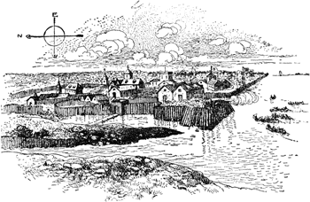
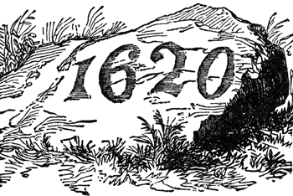
Jamestown vs. Plymouth
Today's Date
Jamestown
Plymouth
Date
Landed
1607
104 men
1620
102 settlers
Anchorage=GOOD Defense Position
Warm Climate
Fertile Soil (Plantations)
Anchorage=EXCELLENT Harbor
Cold Climate
Thin, rocky soil
Turned to lumber, shipbuilding, trade & fishing
Location

Slide 3
Reasons for Coming
Economics motives
Business venture by the Virginia Company
Religious freedom
Leave England,
go to Holland
BUT…
think kids are losing their English heritage
SO…
go to New World

Slide 4
Setbacks
Inexperience
Unwilling to work
Lack of survival skills
Bickering
Disagreements
Poor Indian relations
Disease (swampy area -> mosquitos)
No family units
John Smith says “You don’t work, you don’t eat.”
Worked well together
BUT…
Were plagued with
- hunger
- disease
- environmental hazards (climate)
Religious Differences
Anglican Faith
Church of England
Come from the Church of England
BUT…
set up their own Puritan Church
(a little twist of the C of Eng.)

Slide 5
Govt
First legislative assembly
Established a self-govt agreement =>
Mayflower Compact
Indians

Slide 6
Indians
Unstable
Strong Indian empire
Befriend the Indians
(Thanksgiving)
3 G’s for Colonization
God – Religious Reasons
Gold – Money Reasons
Glory – Bragging rights (Power)

Slide 7
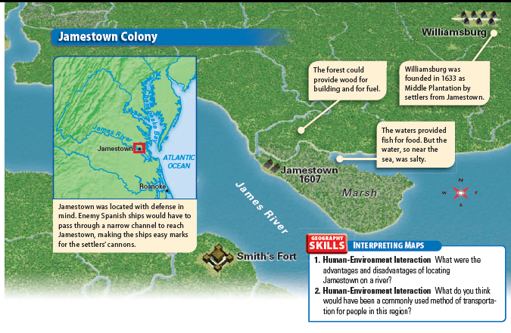
United States History textbook p.73

Slide 8
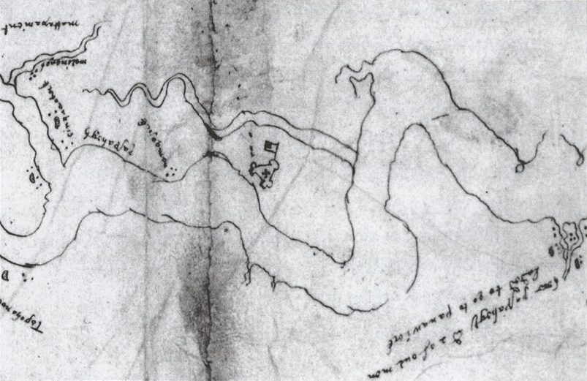
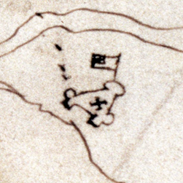
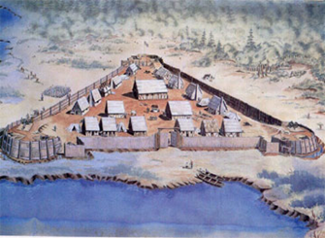
James River
A drawing of James Fort (ca. 1608) by Pedro de Zuniga, the Spanish ambassador to London at the time. The sketch shows a flag-like projection, which is more probably an enclosed garden. The three sides and circular bastions at the corners are common to all three known descriptions of the early fort. http://apva.org/rediscovery/page.php?page_id=461

Slide 9
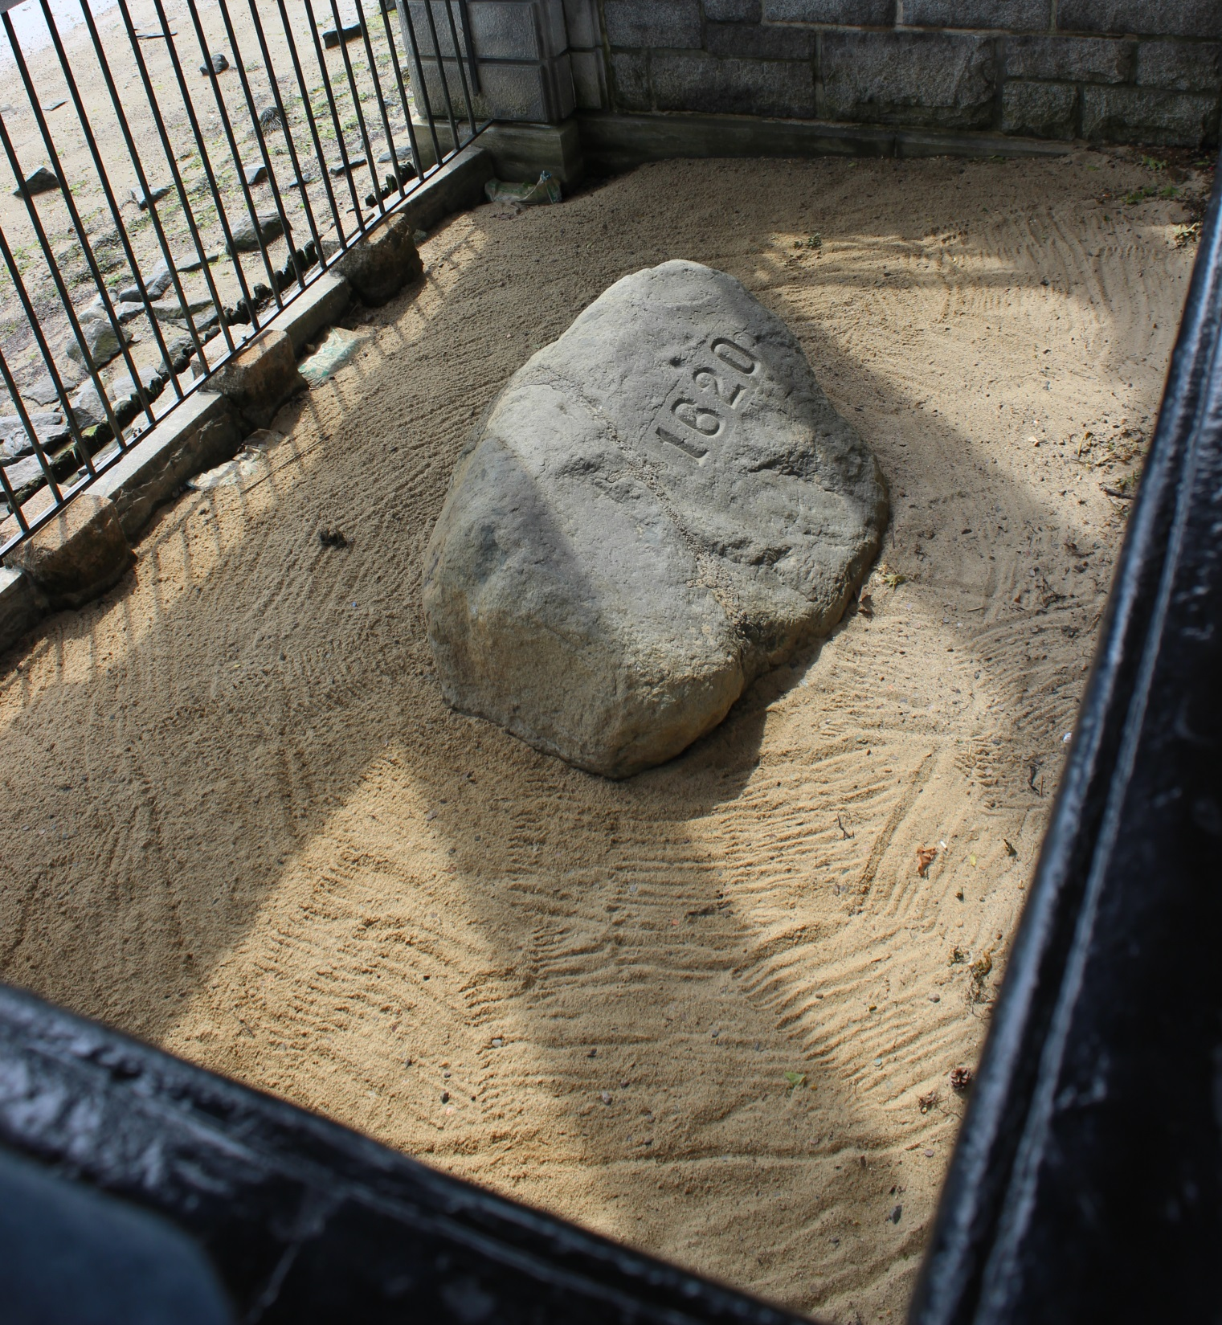
Plymouth Rock
Plymouth, Massachusetts
Boston Trip 2015

Slide 10
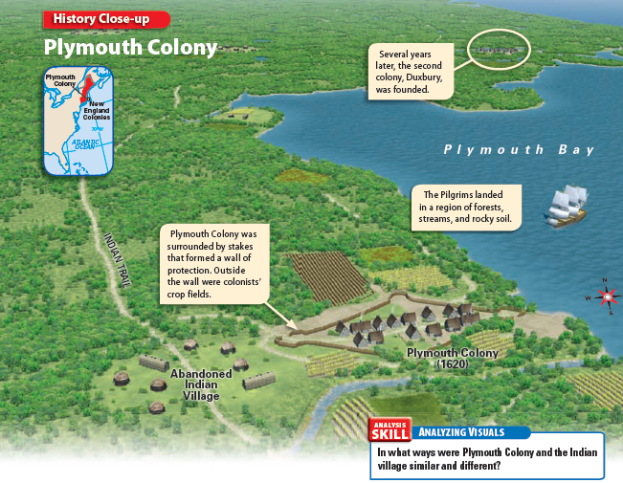
United States History textbook p.81

Slide 11
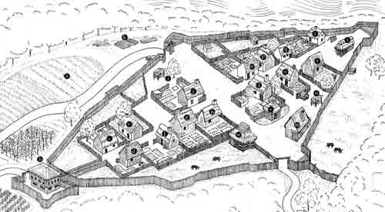
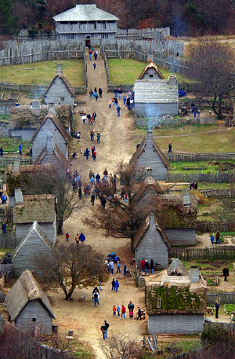
Reconstructed Plymouth Village 1627
http://myweb.tiscali.co.uk/sheena_charles/Photos/PPmap.jpg

Slide 12
Death @ Jamestown: History Channel

Slide 13
Deconstructing History: Mayflower

Slide 14
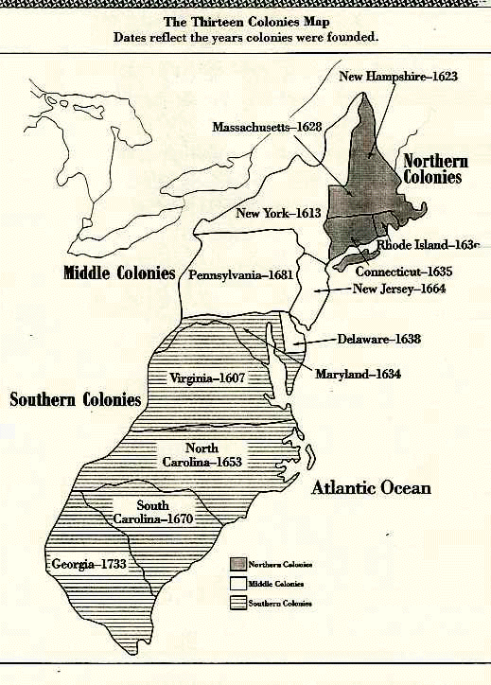
13 Colonies
New England Colonies - blue to represent harsh winters
Middle Colonies - green to represent good soil and growing conditions - "Breadbasket Colonies"
Southern Colonies - red to represent hot and humid conditions

Slide 15
